Slide 1
Salesforce - PAL (aDAM) Integration

Slide 2
PoC Approach

Slide 3
PoC Integration Approach
Process followed;
Identify Relevant API Methods - with the new PAL version aDAM supports Rest API <doc. link>. Went through all API methods and identified the most relevant API method.
Read Files
Read files with unique identifier
Prepared Dummy API Request - to be consumed & supported by aDAM server.
Received Sample API Response (from Rohit)
Consumed API Response - by creating an Apex class in Salesforce – enforcing a DML statement to insert a record within Salesforce capturing the full response message.
Response Handling – updated custom fields in salesforce to refer file records on lightning component.
Future Steps
Request / response messages to be finalized and referred in lightning component.
Parsing, Field Mapping, Login authentication, API methods, Response handling & error handling to be finalized.
However, PAL API for external application is currently not in place. This PoC was conducted with aDAM server directly.

Slide 4
Rest API Integration

Slide 5
B2B Portal – PAL API Rest Integration
The ADAM Assets API allows you to interact with our system programmatically from your own application. Using the API you interact with Resources such as:
Record
Classification, RecordClassification
Field, FieldDefinition
File, FileVersion, FilePreview, AdditionalFile
Image, Watermark
The API follows some aspects of hypermedia-driven web APIs, like using linked/embedded resources in the returned resource representation.
Each resource can be accessed directly through its URI but it can also be accessed as an embedded sub-resource in its parent resource, like collection resource for example. To read a resource, a standard HTTP GET request is used.
The request can include some optional parameters which allow you to control how much of the information should be included/excluded in the returned resource, depending on how much information is needed.

Slide 6
GET : Rest API for PAL Token
Step 1 : Request for PAL Token. Once the Token is available we are into the PAL system and can read, update, delete the data in PAL. Currently using Basic Authentication with username only and accessing the PAL system.
Rest API base URL: https://dev.assetlibrary.philips.com/RestAPI/
API Headers :
Authorization: Basic **********************
Registration: DAMDev
API-Version: 1
accept: application/json
accept-encoding: gzip, deflate
accept-language: en-US,en;q=0.8
user-agent: Mozilla/5.0 (Windows NT 6.3; Win64; x64) AppleWebKit/537.36 (KHTML, like Gecko) Chrome/60.0.3112.113 Safari/537.36
Content-Type: application/json
API Documentation Path : /rest_api_documentation/docs/index.html#gettingstarted_setup

Slide 7
Post : Advance Search Records in PAL
Rest API base URL: https://dev.assetlibrary.philips.com/RestAPI/search/records
API Headers:
Authorization: Token **********************
Registration: DAMDev
API-Version: 1
Pagesize: 200
accept: application/json
accept-encoding: gzip, deflate
accept-language: en-US,en;q=0.8
user-agent: Mozilla/5.0 (Windows NT 6.3; Win64; x64) AppleWebKit/537.36 (KHTML, like Gecko) Chrome/60.0.3112.113 Safari/537.36
Content-Type: application/json
Sort : modifiedOn desc
Returns the List of Record Id’s and all subresources are represented as links to these resources for example Record fields, Record Classification, Record Thumbnail, etc.
We have used Advance Search API for Notification, Latest Files, Search and Related Files Section by dynamically creating the POST request.

Slide 8
Continuation…
Documentation Path :/rest_api_documentation/docs/index.html#usage_searching
POST Body Sample for Latest Files Section
{
"searchExpression":
{
"disabledKeywords": null,
"supportWildcards": true,
"defaultLogicalOperator" : "AND",
"expression": "( Classification.Id = d956ddbdfe1244ed9614a8040081edcd OR
Classification.Id = 488b2f3d885c4d1da4dea8040081ce20)",
"subExpressions": null
}
}

Slide 9
Continuation…
POST Body Sample for Related File Section
{
"searchExpression":
{
"disabledKeywords": null,
"supportWildcards": true,
"defaultLogicalOperator" : "AND",
"expression": "( Classification.Id = 488b2f3d885c4d1da4dea8040081ce20) AND ( FieldName('Asset_Subject_Keywords') contains 'xper' OR FieldName('Asset_Subject_Keywords') contains 'xper flex cardio' OR FieldName('Asset_Subject_Keywords') contains 'veradius neo' OR FieldName('Asset_Subject_Keywords') contains 'idose⁴' )",
"subExpressions": null
}
}

Slide 10
GET : Fetch Record Fields
Once the list of Id’s are available we would follow an iteration process to fetch the data within the fields of the particular Asset.
Rest API Base URL : https://dev.assetlibrary.philips.com/RestAPI/record/f0a8b186d4b74ae1b1a6a817009200f4/fields
API Headers:
Authorization: Token **********************
Registration: DAMDev
API-Version: 1
accept: application/json
accept-encoding: gzip, deflate
accept-language: en-US,en;q=0.8
user-agent: Mozilla/5.0 (Windows NT 6.3; Win64; x64) AppleWebKit/537.36 (KHTML, like Gecko) Chrome/60.0.3112.113 Safari/537.36
Content-Type: application/json
Documentation Path : /rest_api_documentation/docs/resources/record.html#example-read

Slide 11
GET : Fetch Record Classification
Parallel we do a classification mapping for showing the Group Tags in the Portal.
Rest API Base URL : https://dev.assetlibrary.philips.com/RestAPI/record/f0a8b186d4b74ae1b1a6a817009200f4/classifications
API Headers:
Authorization: Token **********************
Registration: DAMDev
API-Version: 1
accept: application/json
accept-encoding: gzip, deflate
accept-language: en-US,en;q=0.8
user-agent: Mozilla/5.0 (Windows NT 6.3; Win64; x64) AppleWebKit/537.36 (KHTML, like Gecko) Chrome/60.0.3112.113 Safari/537.36
Content-Type: application/json
Documentation

Slide 12
GET : Download of Asset (Fetch URI)
The download functionality of the Asset from PAL where it calls the ADAM server look for the Asset ID and fetch the URI.
Based on that File Extension and URI we bind and download the file.
var fileName = "MyReportPDF_";
fileName += ".pdf";
var FileURL =response.getReturnValue();
var link = document.createElement("a");
link.setAttribute('download',fileName);
link.href = FileURL;
link.style = "visibility:hidden";
document.body.appendChild(link);
cmp.set("v.ShowWaitingPanel", false);
link.click();
document.body.removeChild(link);

Slide 13
Business Use Cases

Slide 14
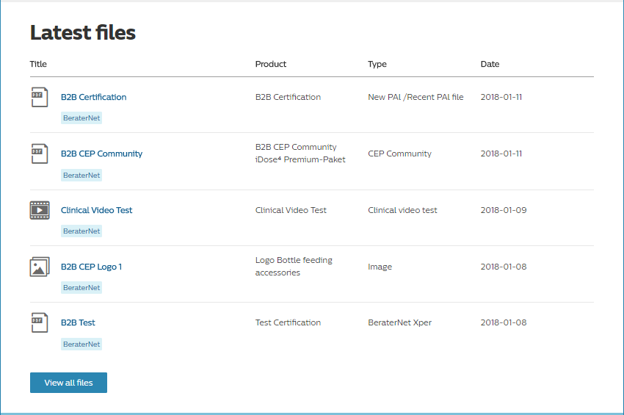
Use Case 1 – Show Latest Files
Latest Files
Need to show the latest 5 aggregated files of all the groups/markets users are part of and it is sort on the basis of Last Modified Date. If the user clicks on view all files it redirects to the Search page where are all the files are accessible to the users.

Slide 15
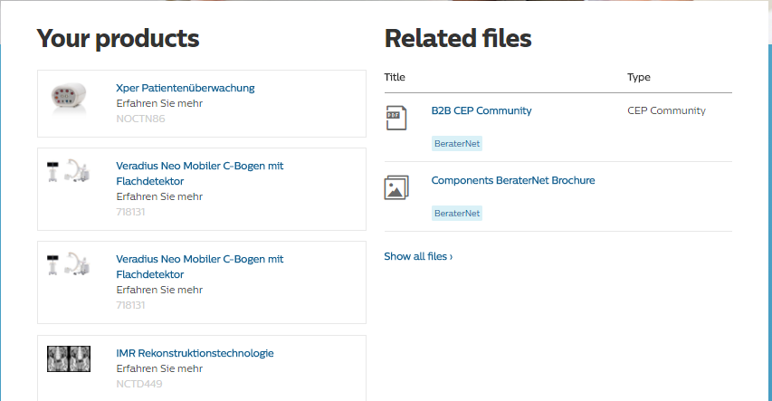
Use Case 2 – Related Product Files
Related Files
Need the PAL files based on the PRX Product Family Name and Product Subcategory. It first check the group/market the user is part of and fetch the PRX Products based out of that group/market and then search the PAL files within that Group/Market Space of PAL.

Slide 16
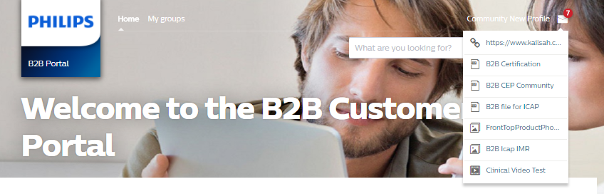
Use Case 3 – Latest Files Notifications
User Notifications
Need to fetch the PAL files and Title of the files in the Notification Section which are added or updated after the logged in user last login. Max files that are fetched as part of notification is 10. If the user clicks on the File notification it is redirected to the Search Page to view the file.

Slide 17
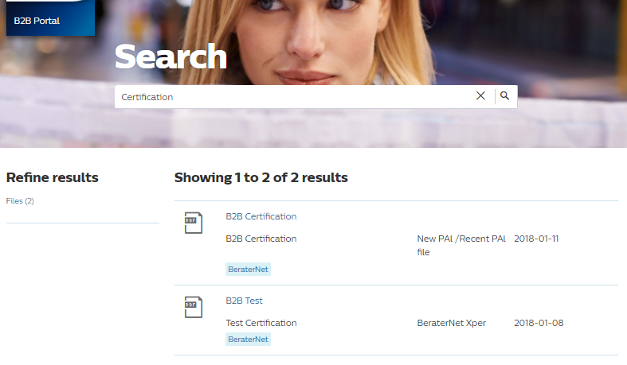
Use Case 4 – Search Files
Search-Page
The user can search the PAL Assets within the Space the user is part of and can access the Assets by downloading the files. The files are filtered from the Metadata fields of PAL as Media Title, Description, Keywords from the PAL server and are visible on the Search Page.

Slide 18
Observations / Findings

Slide 19
Observations / Findings
Search
Search is currently restricted to minimum of 5 characters. This is however more than what salesforce general search bar offers. (minimum 2 character search – salesforce standard)
Asterisk all search is currently not supported.
Fields needs to be enabled at the backend to support Search calls. Not all fields are enabled by default.
1000 Page size is the limit for the PAL Records in one callout
API calls
PAL API currently doesn’t support parallel calling through API. Integration is currently through Iterative calls which results in multiple API calls for each record.

Slide 20
Observations / Findings
Download API
All office and pdf files are currently converted to jpg format by default and needs to be converted to its original format.
Download is not enabled in PAL ????
Dynamic File Extension is pending as part of the API call once the download Api is available.
Note : Performance/Stress Testing for complete end to end PAL integration is pending in Production. Currently not supported in Dev/Test box

